Slide 1
Investor Presentation
2Q 2023

Slide 2
Safe Harbor
Risks Associated with Forward-Looking Statements Included in this Presentation:
This presentation contains certain forward-looking statements within the meaning of the Private Securities Litigation Reform Act of 1995, which are intended to be covered by the safe harbors created thereby. Forward-looking statements include statements which are predictive in nature, which depend upon or refer to future events or conditions, or which include words such as “expect,” “anticipate,” “intend,” “plan,” “believe,” “estimate” or similar expressions. These statements may include the plans and objectives of management for future operations, including plans and objectives relating to future growth of our business activities and availability of funds. Statements regarding the following subjects are forward-looking by their nature:
our business and growth strategies;
our performance goals;
our projected financial condition and operating results;
our understanding of our competition;
industry and market trends;
the impact of technology on our products, operations and business; and
any other statements or assumptions that are not historical facts.
The forward-looking statements included in this presentation are based on current expectations that involve numerous risks and uncertainties. Assumptions relating to these forward-looking statements involve judgments with respect to, among other things, future economic, competitive and market conditions, legislative initiatives, regulatory framework, weather-related events and future business decisions, all of which are difficult or impossible to predict accurately and many of which are beyond our control. These forward-looking statements are not guarantees of future performance, and a variety of factors could cause our actual results to differ materially from the anticipated or expected results expressed in these forward-looking statements. Although we believe that the assumptions underlying these forward-looking statements are reasonable, any of the assumptions could be inaccurate and, therefore, there can be no assurance that the forward-looking statements included in this presentation will prove to be accurate. In light of the significant uncertainties inherent in these forward-looking statements, the inclusion of such information should not be regarded as a representation that our objectives and plans will be achieved.
More information about forward-looking statements and the risk factors associated with our company are included in our annual, quarterly and other reports filed with the Securities and Exchange Commission. The Company does not undertake to update the forward-looking statements to reflect the impact of circumstances or events that may arise after the date of the forward-looking statements.

Slide 3

Company Overview
Property/Casualty insurance holding company serving products to both businesses and individuals that offer an opportunity to achieve attractive returns on capital
Solid foundation of experienced underwriting, actuarial and corporate leadership with proven track records to drive market access and bring industry experience to bear on risk selection and pricing
Maintain a diversified portfolio of products to reduce risk to severity in any one line of business, better weather market cycles, be flexible, and be able to react to favorable rate environments
Leadership Culture & Talent
Business Mix & Targeted Growth
Realigned our underwriting portfolio; exited program business, discontinued binding commercial auto, divested most E&S casualty lines
Strengthened the Claims, IT, Actuarial functions and the control environment
Technical underwriting and pricing expertise allows the Company to be selective on the risks it chooses to write, and enables pricing adequacy over the underwriting cycle
Comprehensive Transformation
Underwriting Excellence
Deploy a disciplined investment approach to maintain a conservative investment risk profile while maximizing long-term after-tax total returns
Manage and maintain a competitive expense ratio, which is an advantage when pricing risks and scaling the business
Capital Management
Technology
Utilize technology to enhance knowledge of our insureds to better price risks through more effective use of internal and external data; and to provide better service to agents and brokers

Slide 4


Company Overview
Company Overview
Value Proposition
Business Strategy
Commercial/Personal lines insurance company headquartered in Dallas, TX with 250+ employees
Targeting primarily small to mid-sized enterprise (SME) risks in niche markets where there is an opportunity to achieve attractive returns on capital
Operating through several unique strategies and organized by product line, the Company is well-positioned to take advantage of the current market opportunities
Maintain a diversified portfolio of products to reduce risk to severity in any one line of business, better weather market cycles, and be flexible and able to adjust capacity to positive rate environments
Invest in talent and expertise with proven track records to drive market access and bring industry experience to bear on risk selection and pricing
Utilize technology to enhance knowledge of insureds (our customers) to better price risks, and to provide better service to agents and brokers (our clients)
Deploy a disciplined investment approach to maintain a conservative investment risk profile while maximizing long-term after-tax total returns

Slide 5


Business Profile
Hallmark Financial seeks to diversify its portfolio in a manner that achieves a balanced risk profile
Lines of Business*
Geography*
We write business in 48 states, and will seek to capitalize on new opportunities and improve our geographic spread of risk
*Charts based on Gross Premiums Written for FY 2022 and presents the lines of business the Company
will move forward with after the sale of substantially all of the E&S operations effective 9/30/22

Slide 6
Product Groups
Our Product Groups are organized by products and distribution channel, led by experienced underwriting teams and supported by actuaries and data scientists
The Company targets small to mid-sized enterprise (“SME”) risks in niche markets where there is an opportunity for attractive returns on capital
The Company’s operations are grouped into product-specific business units that are organized by product lines and distribution channels. These business units are segregated into two industry segments
Each product line is targeted based on profitability and market opportunity with a focus on underserved markets that require specialized underwriting skills
Note: The Company agreed to sell effective September 30, 2022 substantially all of its excess and surplus lines operations to a nonaffiliated entity.
Standard Commercial |  |  | Personal
Commercial Accounts (CIS) | Aviation | Workers Compensation | Personal Lines | Runoff
Commercial Package for SME risks within targeted specialties | Personal & Small Aircraft; Airport Liability | Employee Worker Compensation for SME | Non-standard Auto & Renters | Binding Primary Auto; Hospitals; Business produced by MGAs
Retail Agents | Retail Agents | inactive | Retail | inactive
 |  |  | Agents
Admitted | Admitted | Admitted | Admitted | Admitted & E&S

Slide 7
Q2 2023 Results
Q2 2023
Q1 2022 Results
Year-to-Date
Net Loss: | $(11.9) million or $(6.55) per share¹
Operating Loss²: | $(12.4) million or $(6.83) per share¹
Combined Ratio: | 157.3%
Gross Premiums Written: | -2.7%
Net Premiums Written: | 17.2%
Net Loss: | $(51.0) million or $(28.08) per share¹
Operating Loss²: | $(17.4) million or $(9.56) per share¹
Combined Ratio: | 185.9%
Gross Premiums Written: | -3.2%
Net Premiums Written: | 9.6%
Book Value Per Share | $6.81
Impacting Q2 Continuing Operations Results:
Combined Ratio of 157.3 points is inclusive of 2.8 points from catastrophe losses and 24.5 points from unfavorable prior year loss development
10.7 points of combined ratio from write-off of receivable from reinsurer
Unfavorable prior loss development primarily driven by exited contract binding line of business
Impacting Year-to-Date Continuing Operations Results:
Combined Ratio of 185.9 points is inclusive of 3.8 points from catastrophe losses and 16.1 points from unfavorable prior year loss development
51.1 points of combined ratio from write-off of receivable from reinsurer
Q1 2022
(1) Calculated based on Diluted Shares, includes the effect of the one-for-ten reverse stock split effective 1/1/2023
(2) Non-GAAP reconciliation provided in the appendix
(3) Includes the effect of the one-for-ten reverse stock split effective 1/1/2023
Note: all percentage changes on this page are in comparison to the same period the prior year

Slide 8

Gross and Net Premiums
Gross Premiums Written
$500
$442
$443
$485
2022 Premiums reducing due to the maturing of our runoff lines of business that we exited in prior periods
$347
($ IN MILLIONS)
$234
$217
$250
$0
2017
2018
2019
2020
2021
2022
Commercial
Runoff
Personal
Net Premiums Written
The Company places reinsurance as appropriate to manage its capital base via the use of quota share, excess of loss, and Catastrophe coverage.
$350
$328
$312
$341
$44
$44
$31
$246
$70
($ IN MILLIONS)
$167
$175
$151
$0
Commercial
Runoff
Personal

Slide 9
Operating Performance
Calendar Year Combined Ratio
Loss Portfolio
Transfer
11.1
Prior Year
Development
107.9%
108.0 %
110.7 %
97.1%
4.5
1.6
2.1
2.6
1.2
4.8
4.8
Catastrophe Losses
Expense Ratio
Accident Year Loss Ratio
Prior Year Development
Receivable Write-off
Catastrophe Losses
The 2nd quarter of 2023 experienced $1.0 million net CAT losses which contributed 2.8 points to the combined ratio. This is in line with the recent past historical experience.
Adverse Prior Year Reserve Development added $11.6 million in net losses and contributed 16.1 points to the year-to-date 2023 combined ratio driven primarily by our exited contract binding business; $36.8M write-off of receivable from reinsurer added 51.1 points to the year-to-date 2023 combined ratio .

Slide 10
Investment Highlights: Liquidity and Short Duration
Investment Highlights
Debt Portfolio
Debt By Classification
The portfolio has significant liquidity at 6/30/2023
  $188 million in total cash and treasury bills
  92% of debt securities having maturities of five years or less
  No illiquid hedge funds, private equity investments, private placements
A short duration of 0.7 years protects the balance sheet from the impact of interest rate increases
As of 6/30/2023
As of 6/30/2023
Size: |  | $296M
Duration: |  | 0.7 yrs
Avg. Rating: |  | Baa1
Book Yield: |  | 4.0%
Tax-Adj Yield: |  | 4.1%
Asset Backed
$1M, 0.5%
Total Cash & Investments
Cash and invested assets reduced in 2020 due in part to the LPT transaction, while 2022 & 2023 reduced in part to discontinuing the bulk of our excess & surplus operations
Cash and invested assets represented ~39% of total assets in Q2 2023
Equities By Type
Asset Allocation
As of 6/30/2023
As of 6/30/2023
Equities
$23M, 5%
Bank Loans $49.5M, 10%
$729
$668
$731
$645
$696
$543
Mid Cap, $8M
35%
Cash & Cash Equivalents $165M, 34%
Fixed Income $246M, 51%
Small Cap, $5M
22%

Slide 11
Investment Strategy and Philosophy
Maximizing reported net investment income is secondary in importance to managing credit risk and optimizing after-tax total return through investments in tax-advantaged securities and securities with potential for significant capital appreciation
Debt Securities
Equity Securities
Broadly diversified selection of risks
Primarily investment grade bonds; utilize tax-exempt securities to enhance after-tax returns
Floating-rate bank loans provide protection against rising rates, first lien collateralization superior to unsecured senior bonds
Primarily long-term holdings with potential for significant capital appreciation
Rigorous value-based investment discipline focused on individual security selection
Opportunistic approach seeks to capture value resulting from market-related price dislocations and short-term orientation of market participants
Tax-Adjusted Yield

Slide 12

Book Value Per Share
Book Value Per Share
The 36% decline from 2019 to 2020 was largely due to the write down of Goodwill and intangible assets in Q1 2020. The 66% decline from 2021 to 2022 was driven by adverse prior year reserve development and an allowance recorded on our deferred tax asset. The 79% decline from 2022 to 2023 was driven by a write down of a receivable from a reinsurer.
Tangible Book Value Per Share¹
Tangible Book Value Per Share decreased 79% from year-end 2022.
This reduction was primarily driven by a write down of a receivable from a reinsurer.
      *2019 and 2020 BVPS and TBVPS per share were restated for the correction of an immaterial error related to certain reinsurance treaties and other
      items related to prior periods.
      All figures presented above reflect the effect of a one-for-ten reverse stock split effective 1/1/2023
(1) Non-GAAP reconciliation provided in the appendix

Slide 13
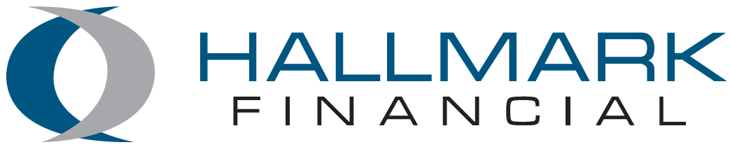
Supplemental Information

Slide 14
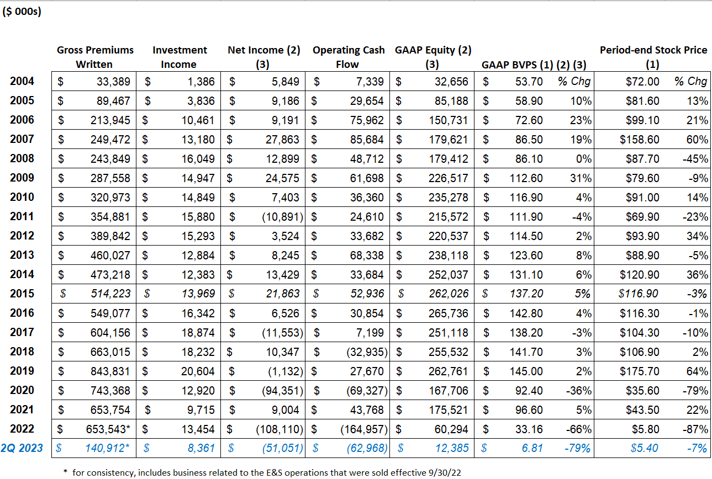
Historical Data
(1) Stock prices and BVPS is adjusted for a) the one for six reverse stock split effective Q3 2006 and the one for 10 reverse stock split effective 1/1/2023
(2) FY2010 and FY2011 Net income, Equity and BVPS have been restated for change in accounting principle related to deferred acquisition costs.
(3) FY2019 and FY2020 Net income, Equity and BVPS have been restated for the correction of an immaterial error related to certain reinsurance treaties and other items related to prior periods.

Slide 15
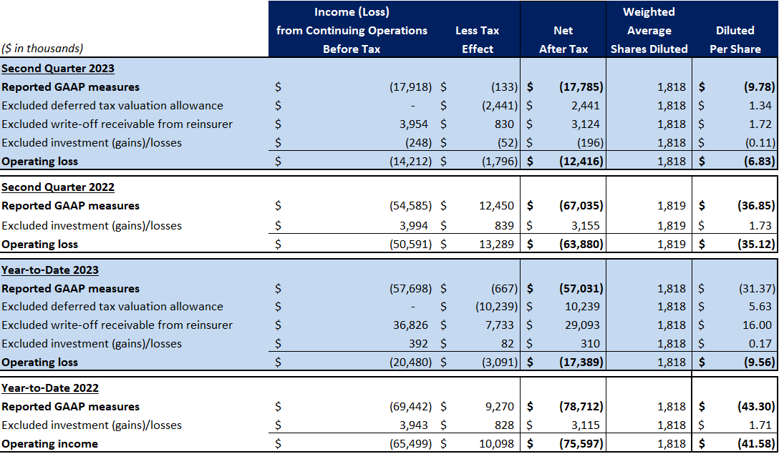
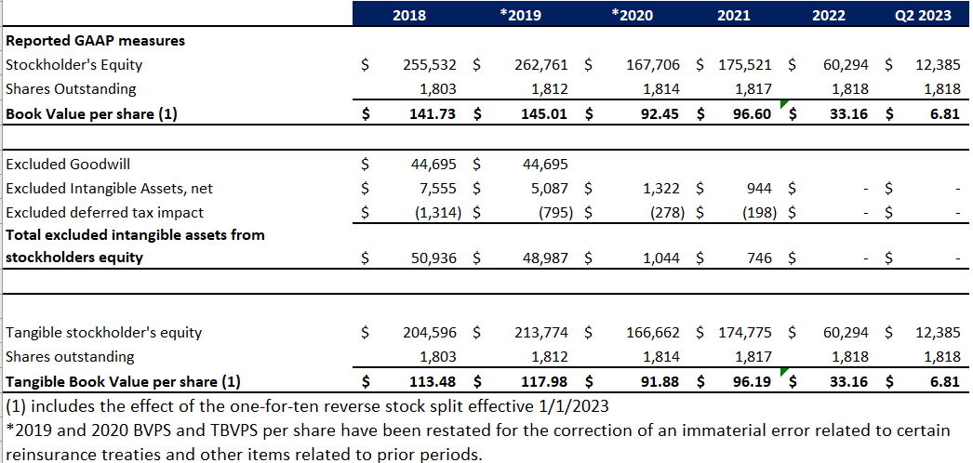
Non-GAAP Reconciliation
Non-GAAP Financial Measures
The Company’s financial statements are prepared in accordance with United States generally accepted accounting principles (“GAAP”). However, the Company also presents and discusses certain non-GAAP financial measures that it believes are useful to investors as measures of operating performance. Management may also use such non-GAAP financial measures in evaluating the effectiveness of business strategies and for planning and budgeting purposes. However, these non-GAAP financial measures should not be viewed as an alternative or substitute for the results reflected in the Company’s GAAP financial statements. In addition, the Company’s definitions of these items may not be comparable to the definitions used by other companies.
Operating earnings and operating earnings per share are calculated by excluding net investment gains and losses and asset impairments or valuation allowances from GAAP net income. Asset impairments and valuation allowances are an unusual and infrequent charges for the Company. Management believes that operating earnings and operating earnings per share provide useful information to investors about the performance of and underlying trends in the Company’s core insurance operations. Net income and net income per share are the GAAP measures that are most directly comparable to operating earnings and operating earnings per share. A reconciliation of operating earnings and operating earnings per share to the most comparable GAAP financial measures is presented below.
Tangible book value per share is calculated by dividing tangible stockholders’ equity by common shares outstanding. Tangible stockholders’ equity is calculated by excluding goodwill, net intangible assets, and related deferred tax liabilities from GAAP stockholders’ equity. Management believes that tangible book value per share provide useful information to investors about the Company’s per share equity value exclusive of goodwill and net intangible assets from prior acquisitions. Stockholder’ equity is the GAAP measures that is most directly comparable to tangible shareholders’ equity. A reconciliation of tangible stockholders’ equity and tangible book value per share to the most comparable GAAP financial measures is presented below.

Slide 16
NASDAQ: HALL
For more information, visit www.hallmarkgrp.com

